Slide 1


Solar Powered Automated Multitasking Agricultural Robot Using IOT
ST. MARTIN'S ENGINEERING COLLEGE
(An UGC Autonomous Institute)
Dhulapally, Secunderabad-500100
NBA & NAAC A+ Accredited
www.smec.ac.in
Department of Electronics and Communication Engineering
Project Guide:
Kiranamyee
M.Tech
Presented By:
Yashwanth Reddy Kantareddy (17K81A04E9)
Laharika Anumalla (17K81A04C4)

Slide 2
Abstract
Agriculture plays a vital role in socio-economic development of India. Agriculture is the cultivation of animals, plants, fungi, and other life forms for food, fiber, biofuel, medicinal and other products used to sustain and enhance human life.
Agriculture is the most essential and foremost economic activity of all times.
Pre-industrial agriculture was typically subsistence agriculture/self- sufficiency in which farmers raised most of their crops for their own consumption instead of cash crops for trade.
The growth rate of agricultural output is gradually declining in the recent years due to labour scarcity and more expensive.
The recent survey shows that the world should double their agriculture productivity to feed the entire booming population by 2050.

Slide 3
Introduction
The primary occupation in a developing country like India is agriculture. But nowadays the number of people involved in agricultural sector is declining due to various reasons.
It is essential to improve the efficiency and productivity of agriculture. By using this project, we can perform various tasks for agricultural purposes.
Despite large-scale mechanization in agricultural field in some parts of the country, most of the agricultural operations in large number of parts are carried on by humans by using simple tools and implements like wooden plough, sickle, etc.
This is specially the case with small and marginal farmers. It results in huge wastage of men power and in lower yields per capita labour force. So, we must mechanise the agricultural operations so that wastage of labour force is avoided, and farming is made convenient and efficient.

Slide 4
Contd…..
Current agricultural practices in India are neither economically nor sustainable and India’s yield for many agricultural commodities are low.
The main factors are poorly maintained irrigation systems and almost universal lack of good extension services. So, this project is also meant for control the irrigation activities.
Increase the yields which not only alleviated the level of hunger, but simultaneously released the human population from the nutritional obstacle to further growth. So continued growth demands even more agricultural improvements.
Through this design the required water supply is automatically monitored and used whenever needed. Some farmers are unaware of the technological developments in farming.
Now our country is self-sufficient in food-grains. It is now able to export surplus food-grains and some other agricultural products to other countries.

Slide 5
Existing System
The main reason behind automation of farming processes are saving the time and energy required for performing repetitive farming tasks and increasing the productivity of yield by treating every crop individually using precision farming concept.
Designing of such robots is modeled based on particular approach and certain considerations of agriculture environment in which it is going to work.
These considerations and different approaches are discussed in this paper. Also, prototype of an autonomous Agriculture Robot is presented which is specifically designed for seed sowing task only.
It is a four wheeled vehicle which is controlled by LPC2148 microcontroller.

Slide 6
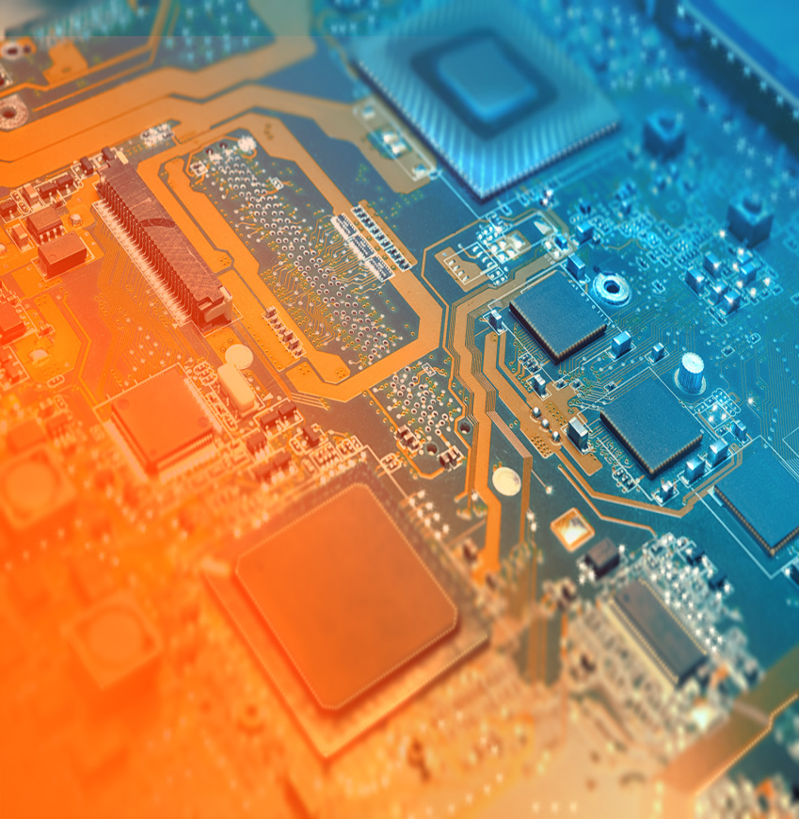
System requirements
In this project we need two softwares to be installed in the PC.
Firstly, we need to install a software called PROTEUS, in which we can check the project virtually whether the embedded project would work on not before going on to the hands-on process.
The second one is the ARDUINO IDE software, which is required to execute the code section of the project and dump the code into the microcontroller i.e., Arduino. Later a programming language will be dumped in to the system which provides commands to the system to work.

Slide 7
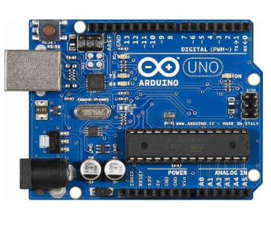
Arduino
Arduino is an open-source electronics platform based on easy-to-use hardware and software.
Arduino board designs use a variety of microprocessors and controllers. The boards are equipped with sets of digital and analog input/output (I/O) pins that may be interfaced to various expansion boards ('shields') or breadboards (for prototyping) and other circuits. The boards feature serial communications interfaces, including Universal Serial Bus (USB) on some models

Slide 8
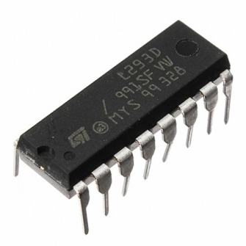
L293D
The L293D is a popular 16-Pin Motor Driver IC. As the name suggests it is mainly used to drive motors.
A single L293D IC is capable of running two DC motors at the same time; also the direction of these two motors can be controlled independently.
So if you have motors which has operating voltage less than 36V and operating current less than 600mA, which are to be controlled by digital circuits like Op-Amp, 555 timers, digital gates or even Micron rollers like Arduino, PIC, ARM etc..

Slide 9
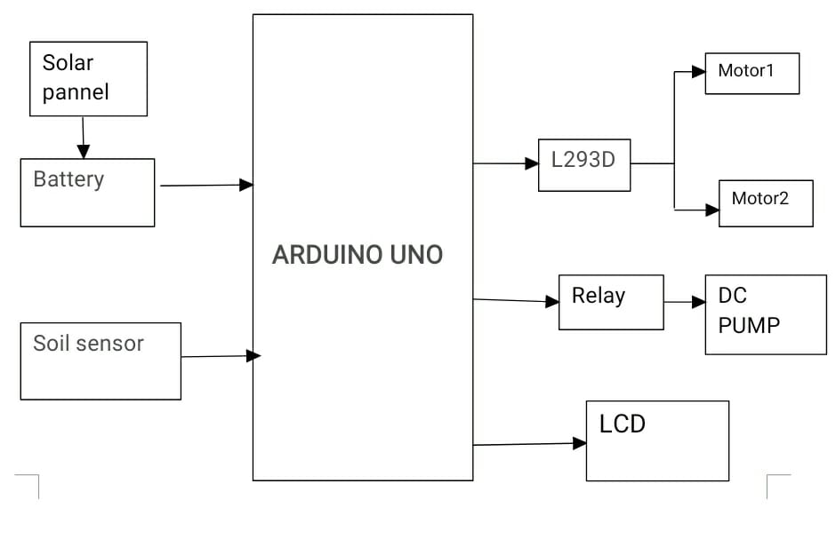
Block diagram

Slide 10
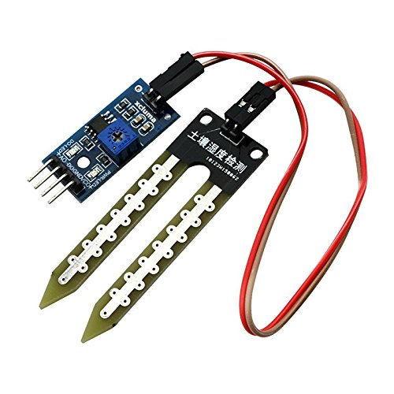
Soil sensor
Soil sensors measure the volumetric water content in soil.
Since the direct gravimetric measurement of free soil moisture requires removing, drying, and weighing of a sample, soil moisture sensors measure the volumetric water content indirectly by using some other property of the soil, such as electrical resistance, dielectric constant, or interaction with neutrons, as a proxy for the moisture content.
The relation between the measured property and soil moisture must be calibrated and may vary depending on environmental factors such as soil type, temperature, or electric conductivity.

Slide 11
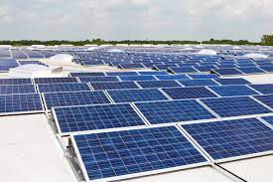
Solar Pannel
A solar panel, or photo-voltaic(PV) module, is an assembly of photo-voltaic cells mounted in a framework for installation.
Solar panels use sunlight as a source of energy and generate direct current electricity.
A collection of PV modules is called a PV panel, and a system of panels is an array. Arrays of a photovoltaic system supply solar electricity to electrical equipment.

Slide 12
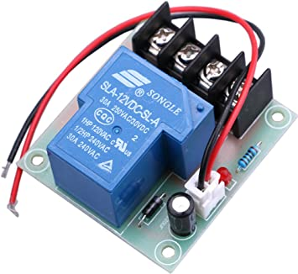
Relay
A relay is an electrically operated switch.
It consists of a set of input terminals for a single or multiple control signals, and a set of operating contact terminals.
The switch may have any number of contacts in multiple contact forms, such as make contacts, break contacts, or combinations thereof.
Relays are used where it is necessary to control a circuit by an independent low-power signal, or where several circuits must be controlled by one signal

Slide 13

Proteus
The Proteus Design Suite is a Windows application for schematic capture, simulation, and PCB (Printed Circuit Board) layout design. It can be purchased in many configurations, depending on the size of designs being produced and the requirements for microcontroller simulation. All PCB Design products include an autorouter and basic mixed mode SPICE simulation capabilities.
Schematic capture in the Proteus Design Suite is used for both the simulation of designs and as the design phase of a PCB layout project. It is therefore a core component and is included with all product configurations.

Slide 14

Arduino IDE
The Arduino Integrated Development Environment is a cross-platform application that is written in functions from C and C++.
It is used to write and upload programs to Arduino compatible boards, but also, with the help of third-party cores, other vendor development boards.
It employs the program avrdude to convert the executable code into a text file in hexadecimal encoding that is loaded into the Arduino board by a loader program in the board's firmware.

Slide 15
Components
Hardware Specification:
Battery
LCD
L293D
Motors
Soil sensor
Arduino uno
Relay
Submersible Motor
Software specification:
Arduino IDE(Integrated Development Environment)
IOT(Internet Of Things)

Slide 16
Conclusion
Multi-tasking agriculture robot has successfully implemented and tested for various functions. It was developed for integrating agricultural robot using programming. The advantages of Multi-tasking agricultural robots are reducing human effort, ensuring proper irrigation and efficient utilization of all resources. The proposed system is mainly used solar power supply for working for plant care and selective harvesting. In future, it can be extended by using soil monitoring and cameras for performing the same operations without human operator for measuring the various parameters like soil condition.

Slide 17
Future scope
Apart from seeding, irrigation, fertilization and fruit picking, harvesting, weeding, monitoring etc. can also be implemented in this robot. And one or more system can be, monitoring through the image processing and GSM system. Then it also includes weeding and harvesting in this system.

Slide 18
References
[1] Shivprasad B S, Ravishankara M N, B N Shoba” Design and Implementation of Seeding and Fertilizing Agriculture Robot.” International Journal of Application or Innovation in Engineering &Management(IJAIEM), Volume 3, Issue6, June 2014.
[2] Swati D.Sambare, S.S.Belsare “Seed Sowing Using Robotics Technology.” International Journal of scientific research and management (IJSRM) Volume- 3,Issue5,Pages 2889-2892-2015.
[3] Nitin Kumar Mishra, Shashwat Khare, Sumit Singh, Mithun Dabur.” Multi-Purpose Agriculture Machine” International Journal of Advances in Science Engineering and Technology, ISSN: 2321-9009, Vol-5, Iss-1, Spl. Issue-2 Feb.-2017
[4] Mahesh R. Pundkar “Performance of Seeding, Plowing and Plant Cutting Devices by Using Image Processing Algorithm Using Flash Magic”.

Slide 19
Contd..
[5] Adyta kawadaskar “Seed Sowing Machine Using CAD”.
[6] Joginder Singh “ The Effect of Farm Mechanization on Indian Economy”.
[7] P.Vijay1, K.V.N.Rakesh2, B.Varun.” Design of A Multi-Purpose Seed Sower Cum Plougher.” International Journal Of Emerging Technology and Advanced Engineering,(ISSN 2250-2459, ISO 9001:2008 Certified Journal ,Volume 3, Issue 4, April 2013).
[8] Akshatha.T, Bharathi Malakreddy A, Harinath K “Street Light Automation using IoT” International Journal of Scientific Research and Engineering Trends, in volume 04, Issue 02, Mar-Apr 2018,Page 301-303.
[9] Sarika C G, Bharathi Malakreddy A, Harinath K “IoT Based Smart Login using Biometrics” International Conference on Computer Networks and Inventive Communication Technologies, April 2018.

